Slide 1
Dr. Diego Colombo
Principal Software Engineer .NET Interactive

Slide 2
Next Steps: Getting Top Marks for your next assignment
Ace your next assignment with .NET and test driven development tips and techniques

Slide 3
Next Steps: Getting Top Marks for your next assignment
How to get it done? More important is the question :
“what does DONE mean?”
Done means that the task we completed satisfies the requirements and specifications, does not mean it is perfect, it means it performs exactly as expected.
When expectations are agreed upon, they can be called Acceptance criteria.
What if we apply this concept while tackling the assignment we have? Does this mean we checked all the boxes?

Slide 4
Next Steps: Getting Top Marks for your next assignment
This is called
Test
Driven
Development
TDD for you, my friends.
What is all about?

Slide 5
Next Steps: Getting Top Marks for your next assignment
You can read more here : https://aka.ms/visualstudio_dev_intro
but let’s understand the core, let’s understand why we test.
Usually, you will do it because
You want to be sure that you are building the right thing
You want to be sure it behaves correctly
You want you solution to be approved
You want to be able to improve if you have time without breaking anything

Slide 6
Next Steps: Getting Top Marks for your next assignment
Creation is a cycle of tests definition and refactoring. Guess what … Visual Studio and .NET can make it a lot easier.
C# ‘s compiler Roslyn integrates with Visual Studio to give you lots of help and enabling refactoring gestures!
Light bulbus and quick fixes can help you generating classes, methods, update signatures and lots more.
And then there is Live Unit Testing (LUT), this tool keeps an eye on code changes and automatically executes the impacted tests giving us feedback immediately about the results!
Let’s use those incredible features to implement our assignment with 100% pass guarantee.
MS is not liable and doesn’t guarantee top marks.

Slide 7
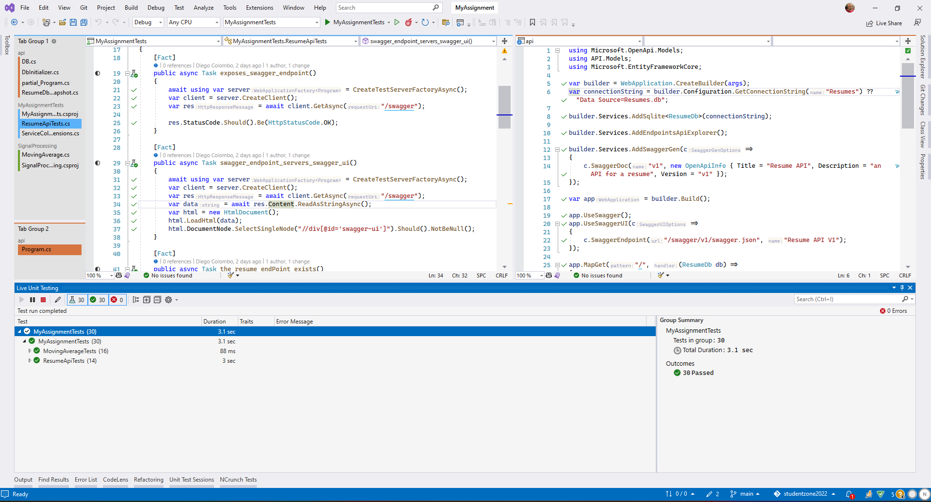
Show Time
Let’s head over to
Visual Studio

Slide 8
Student Resources http://aka.ms/learnstudent Cloud Skills Challenge https://aka.ms/dotnetstudentcsc GitHub Repo https://github.com/microsoft/dotnetconf-studentzone Introduction to testing https://aka.ms/visualstudio_dev_intro

